Slide 1
Quantile Regression to Understand Interrelationship amongst Stock Exchanges Globally
Dhanashri Kanitkar (75252019009)
Hrishita Bapuram (75252019004)
Shraddha Kodavade (75252019011)

Slide 2
“Regression Analysis is the Hydrogen Bomb of the Statistics Arsenal”
— Charles Wheelan (Naked Statistics)

Slide 3
Key Objectives
To Establish the case for Indian Stock Indices (here, Nifty 50) being affected by Global Stock Indices (by extension, the Exchanges themselves) through statistical exploratory data analysis
To Observe the limitations and explore alternatives to Linear Regression model
To Understand the concept, scope and limitations of Quantile Regression, specifically its use in Financial Analytics
To Design a Quantile Regression Model to establish the relationship between stock exchanges by predicting the net daily change in Nifty 50 value.
To Employ the use of statistical packages and tools including R and Python in performing analysis

Slide 4
Contents
Data Snapshot
Introduction to Quantile Regression
Quantile Regression Analysis Results
EDA, Scatterplots, Correlation Matrix, Assumption Checks, Case for Quantile Regression
Concept, Motivation, Principles, Merits and Comparison with Linear Regression
Model fits, Key insights, Prediction Accuracy, Comparison with Linear fit, Limitaions and Future Scope

Slide 5
1
Introduction to Quantile Regression
Why should we always be mean-minded?

Slide 6
Regression Analysis
Regression analysis is a powerful statistical method that allows you to examine the relationship between two or more variables of interest. ​
Typically, a regression analysis is done for one of two purposes:​
To predict the value of the dependent variable for individuals for whom some information concerning the explanatory variables is available​
To estimate the effect of some explanatory variable on the dependent variable. ​
Regression analysis helps an organization to understand what their data points represent and use them accordingly with the help of business analytical techniques in order to do better decision-making.​

Slide 7
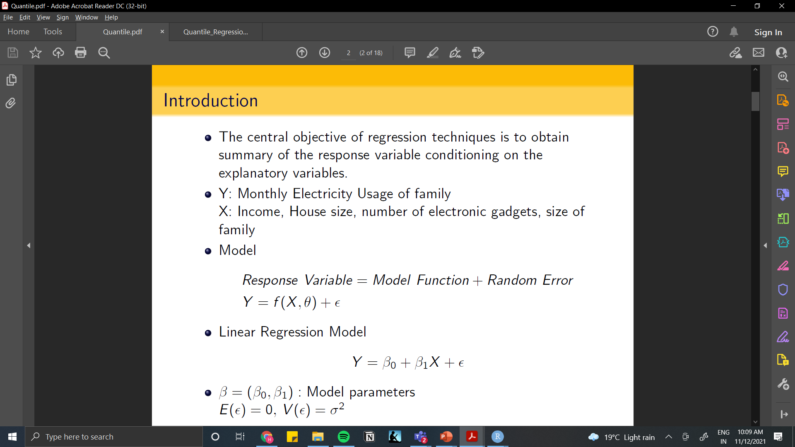
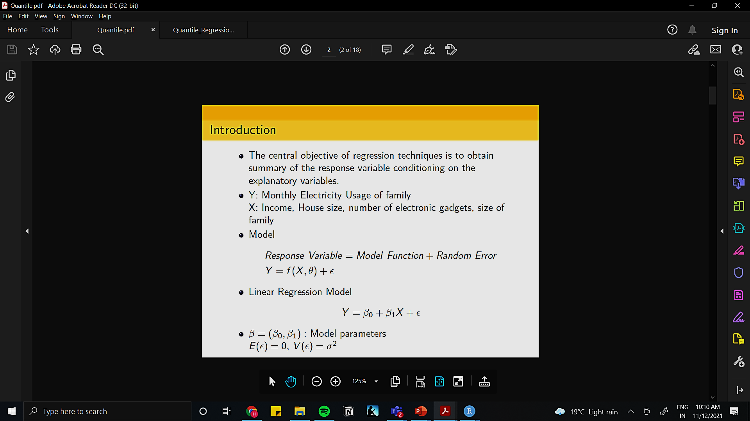
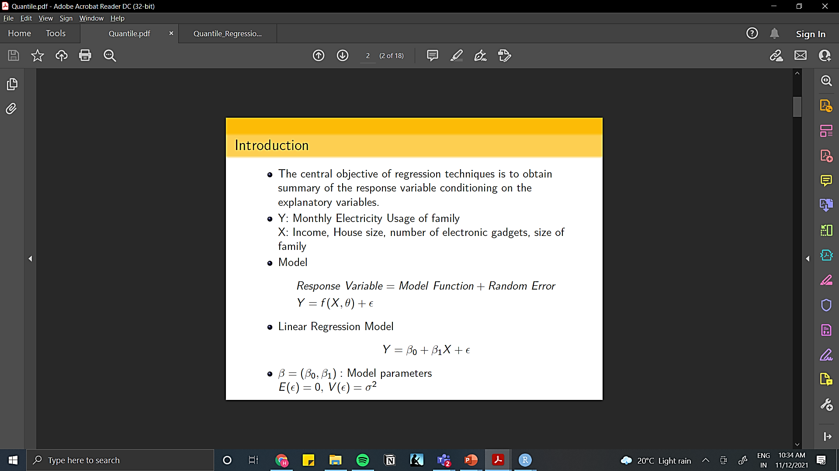
Linear Regression and its Limitations
The central objective of regression techniques is to obtain summary of the response variable conditioning on the explanatory variables.
Y: Monthly Electricity Usage of family
X: Income, House size, number of electronic gadgets, size of family
Model:
Linear Regression Model:

Slide 8
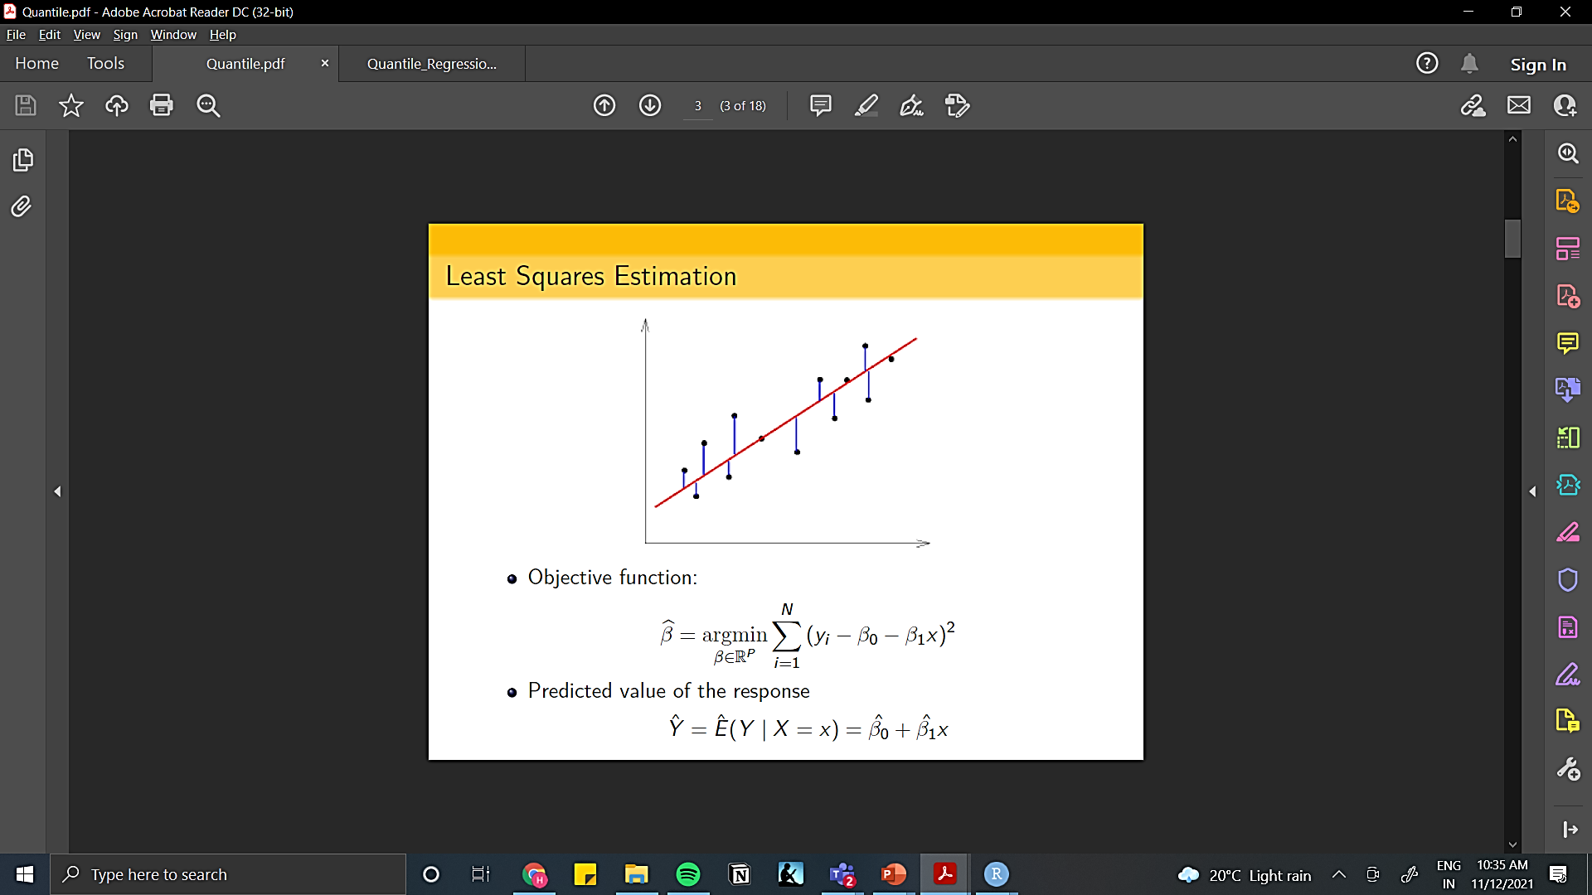
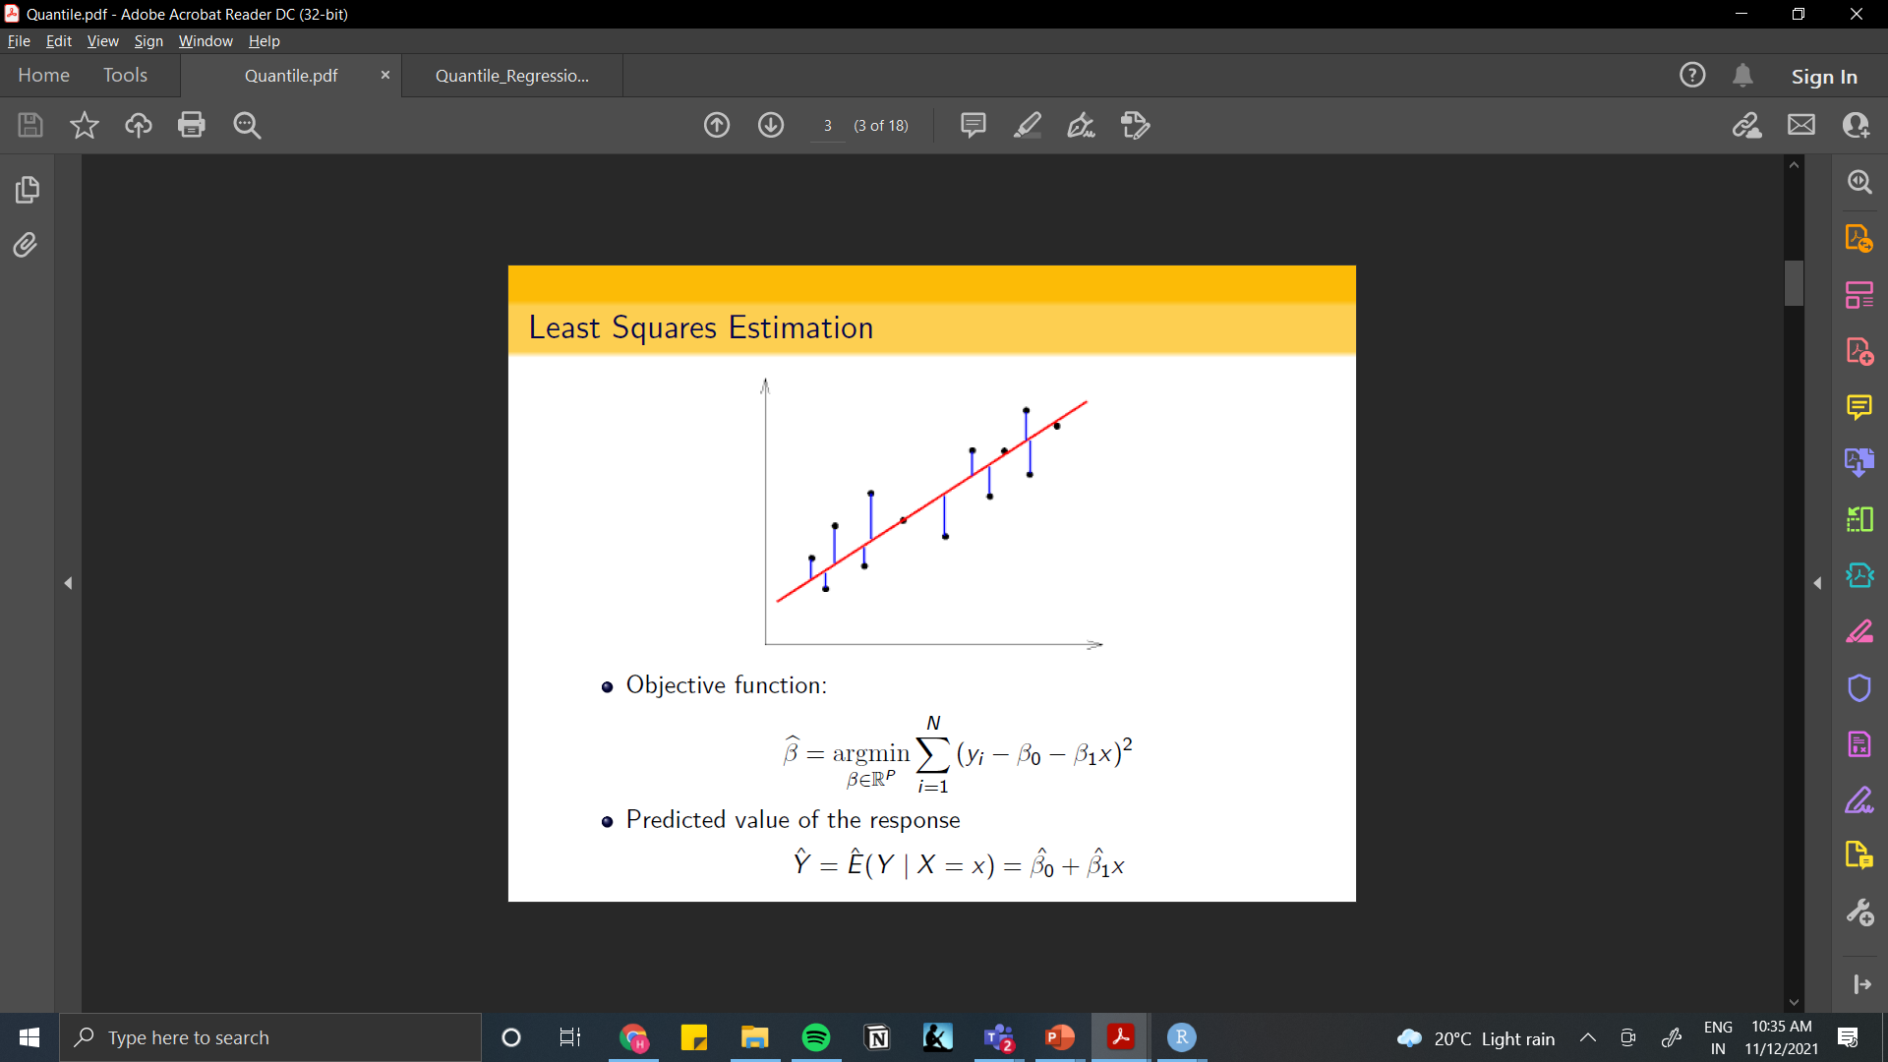
Least Squares Estimation
Gives misleading results when assumptions are violated.
Not efficient in the presence of outliers.
Median regression based on least absolute deviation is an alternative robust method to mean regression.
Can not capture non-central characteristics of the response variable.

Slide 9
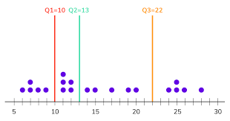
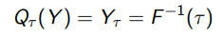
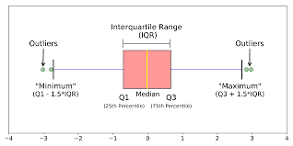
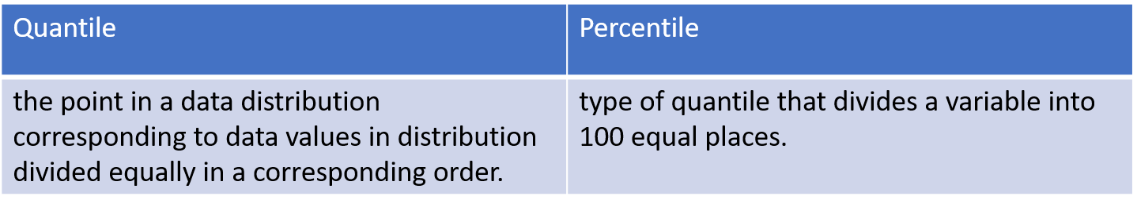
Quantile Regression
Median regression based on least absolute deviation is an alternative robust method to mean regression.
Quantile: The tau−th quantile denotes the value of random variable bellow which proportion of population is tau:
For every given sample, the middle value of such data is called the median, middle quantile, or 50th percentile.

Slide 10
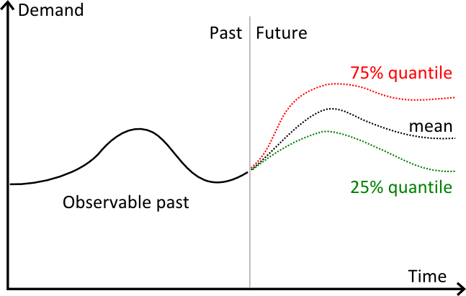
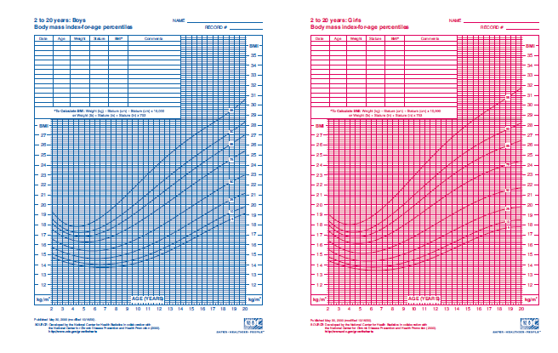
Quantile regression explains non-central summary statistics of the response variable.
It is a method which models quantiles instead of mean for a given set of covariates.
It performs better in the presence of outliers and hence more robust compared to the mean regression.
Quantile regression models response at different levels of quantiles and thus gives the information on the shape of the response distribution.

Slide 11
When to use Quantile Regression?
Data isn't always linear in nature, and could be distributed in a non-linear manner. Some variables may not behave normally and have an efficient linear relationship with predictable variables.
When the linear regression assumptions are not meeting up with each other.
When you have outliers in your data sample.
When the error variables make your outcome variable spike up (Heteroscedasticity)

Slide 12
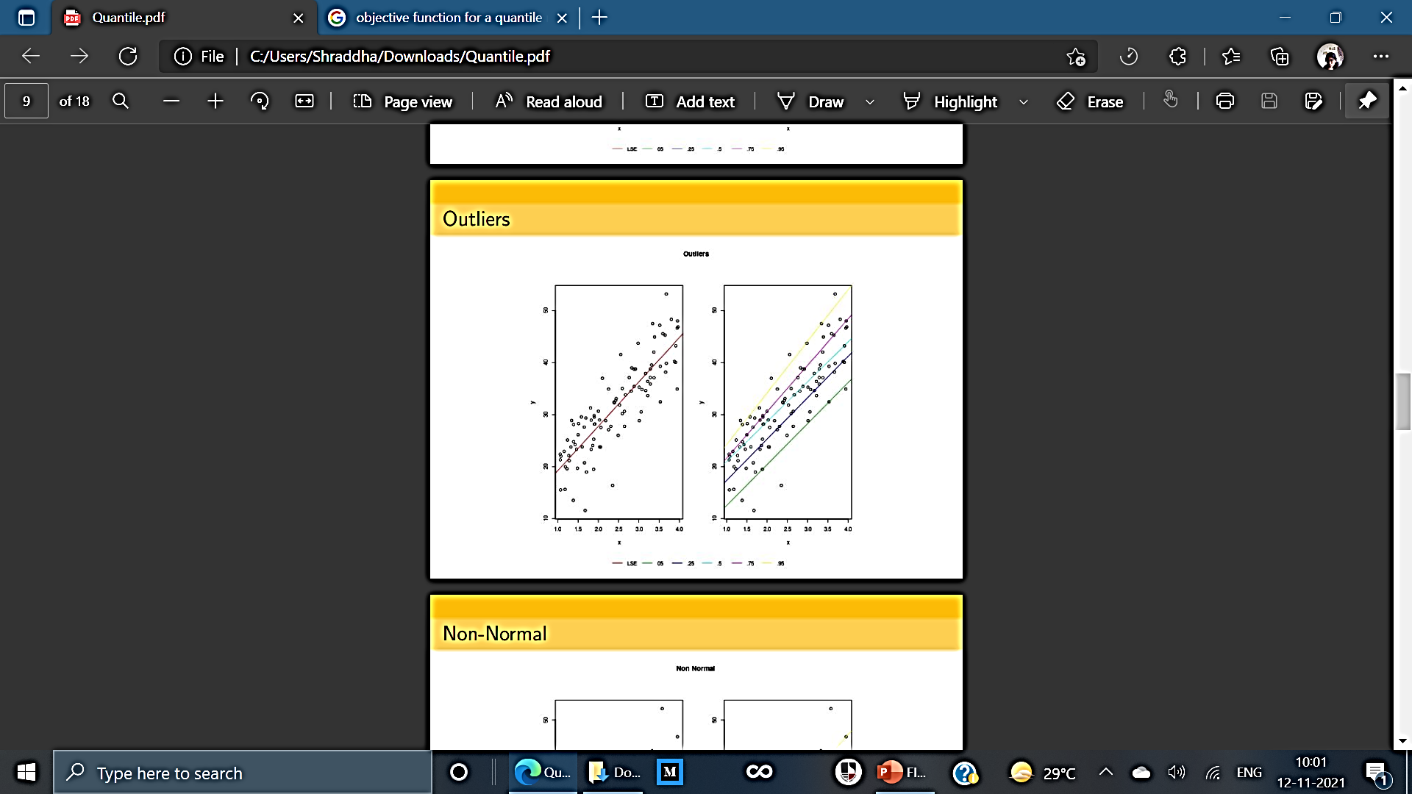
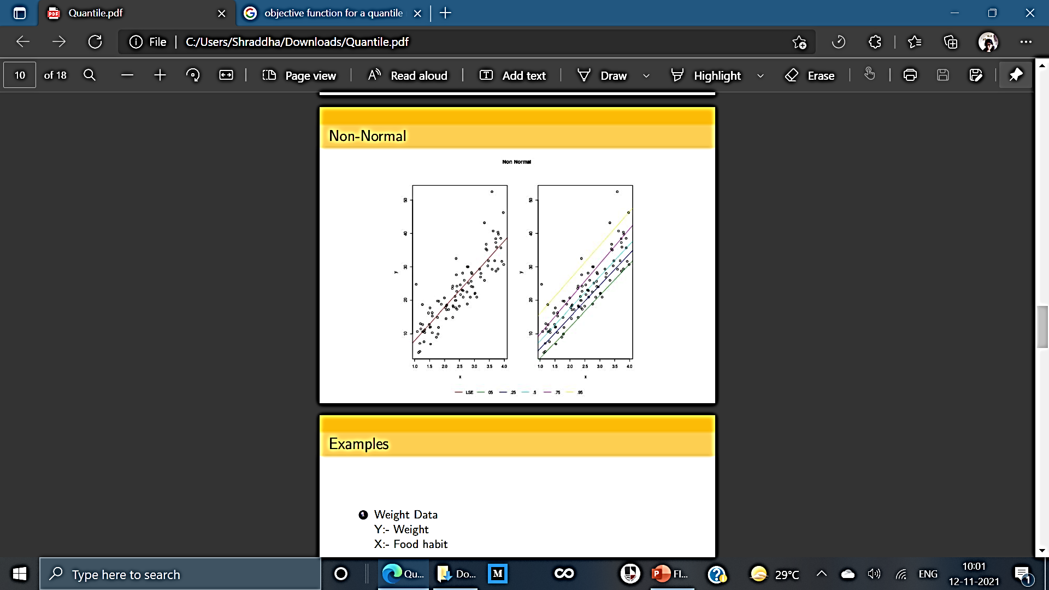
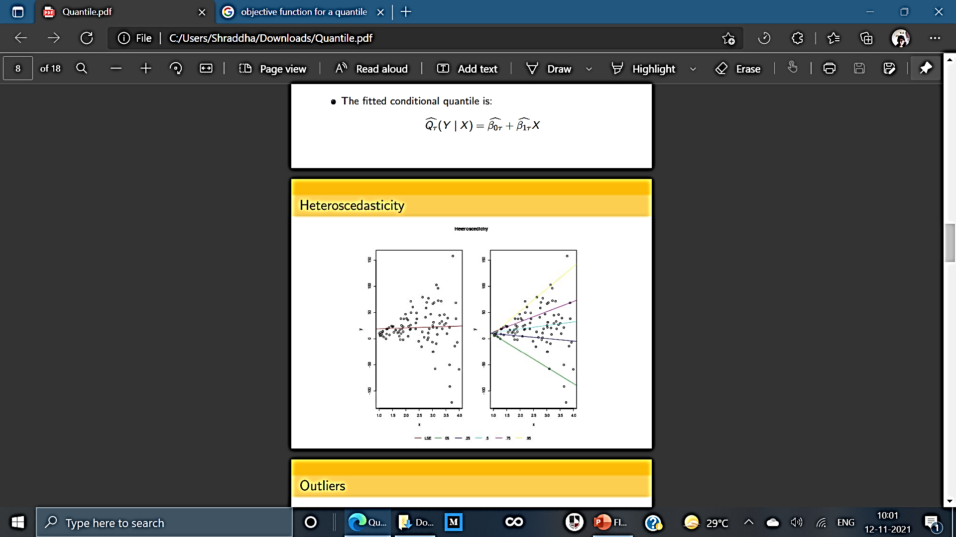
Outliers
Non-Normal
Heteroscedasticity

Slide 13
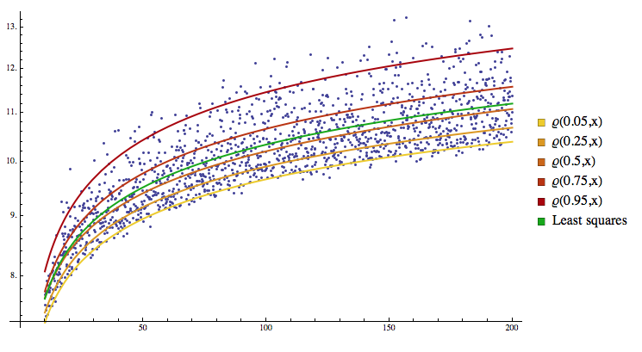
Advantages of Quantile Regression
Quantile regression model not only gives the complete distributional picture, it has several other advantages over the linear regression method.
The objective function of quantile regression makes it more robust in the presence of outliers.
Most importantly, no distributional assumption is needed for the response variable in quantile regression.
Quantile regression allows the analyst to drop the assumption that variables operate the same at the upper tails of the distribution as at the mean; and identifies the factors that are important factors of variables.

Slide 14
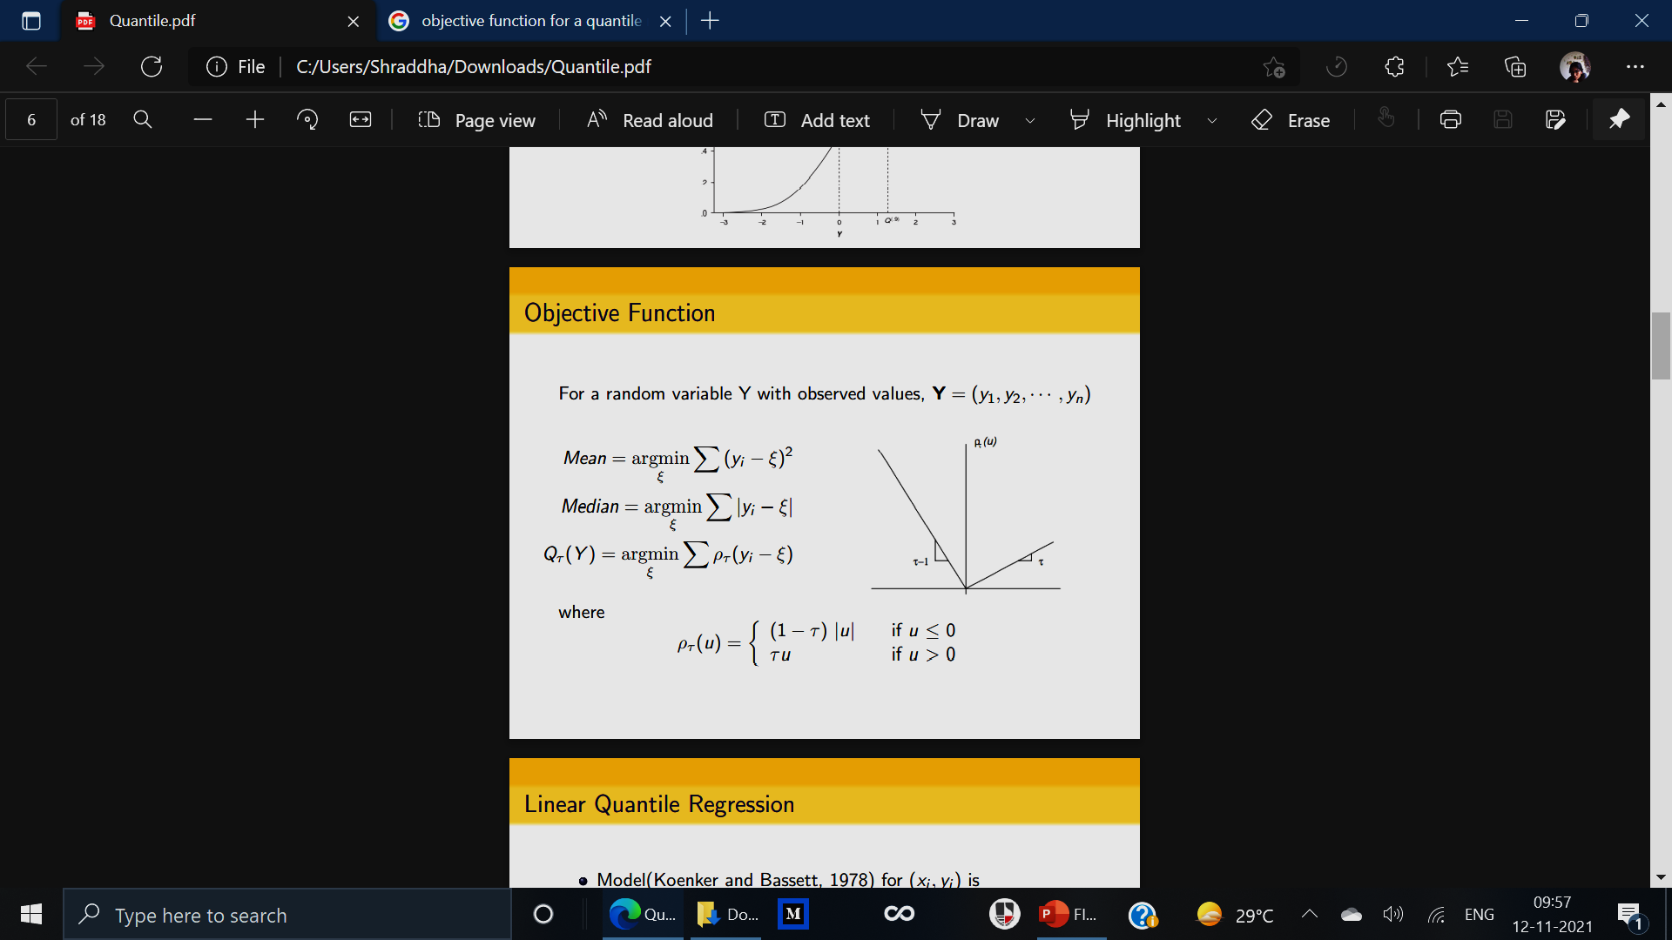

The Math (Stats) of it all!
The quantile regression model equation for the 𝜏th quantile is:
This means that instead of being constants, the beta coefficients are now functions with a dependency on the quantile.
OBJECTIVE FUNCTION:

Slide 15
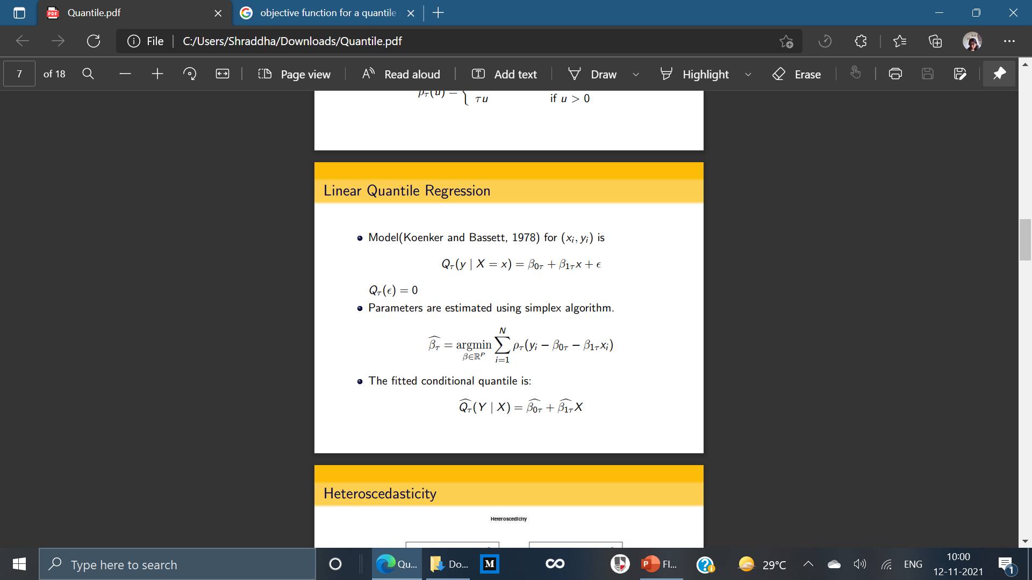
Linear Quantile Regression
Model (Koenker and Basset, 1978) for (xi, yi) is:
Parameters are estimated using Simplex Algorithm
The Fitted Conditional Quantile is:

Slide 16
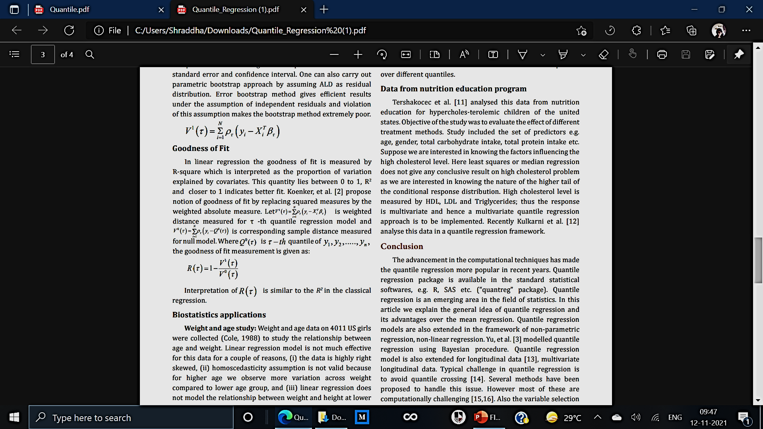
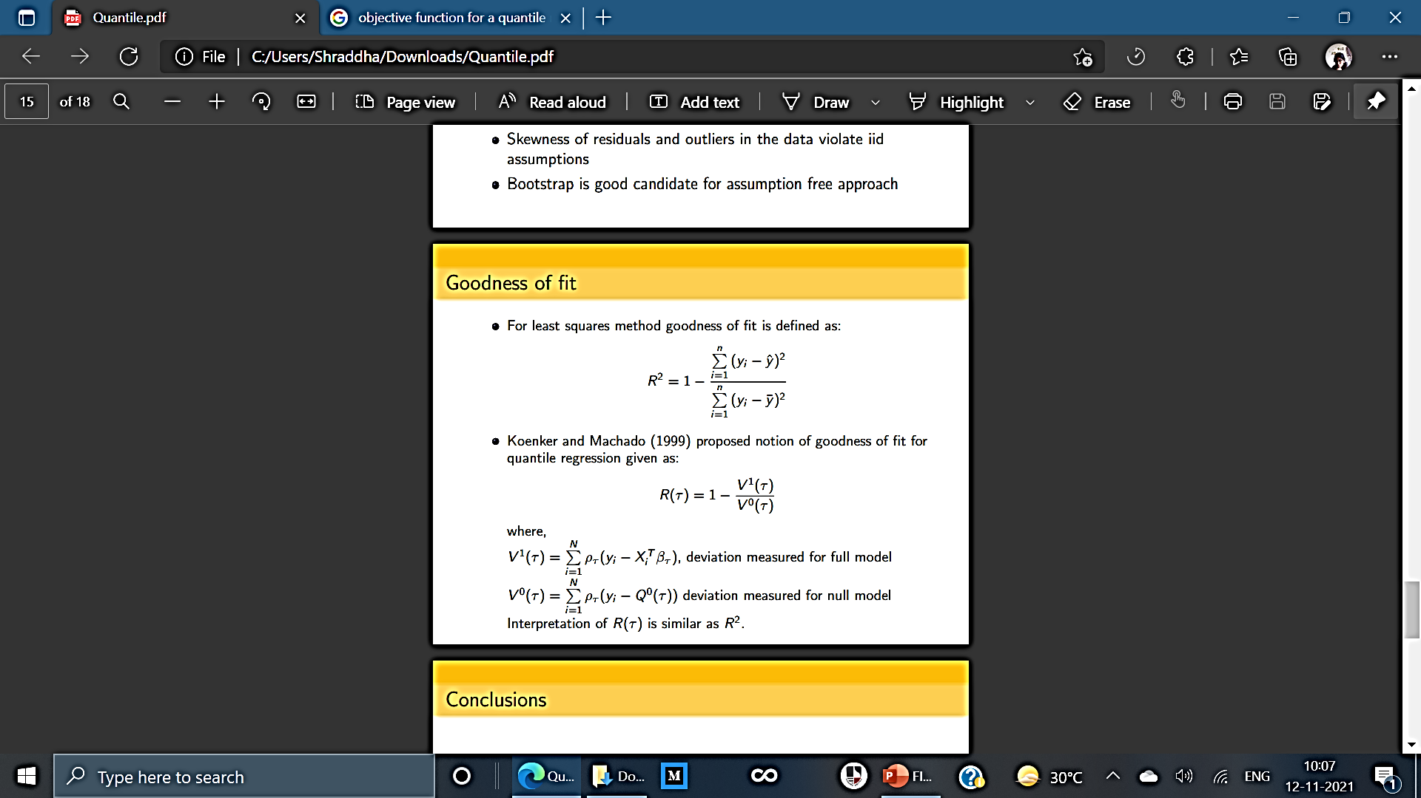
Goodness of Fit
In linear regression the goodness of fit is measured by R-square which is interpreted as the proportion of variation explained by covariates.
A notion of goodness of fit by replacing squared measures by the weighted absolute measure is introduced here. Interpretation of R(τ ) is similar to the R2 in the classical regression.

Slide 17
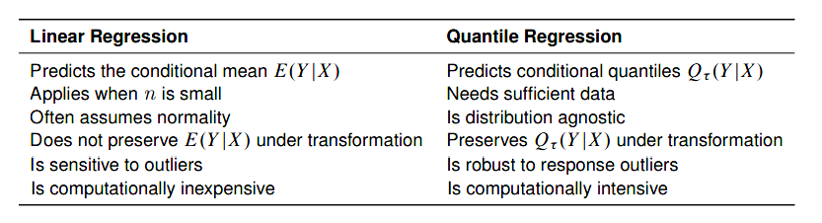
Linear Regression Vs. Quantile Regression
When performing regression analysis, it isn’t enough to come up with a numerical prediction to a problem, we also need to express how confident we are in that prediction.
Apart from this, their other loopholes in analyzing data across a specific distribution having a fixed mean across the whole data.

Slide 18
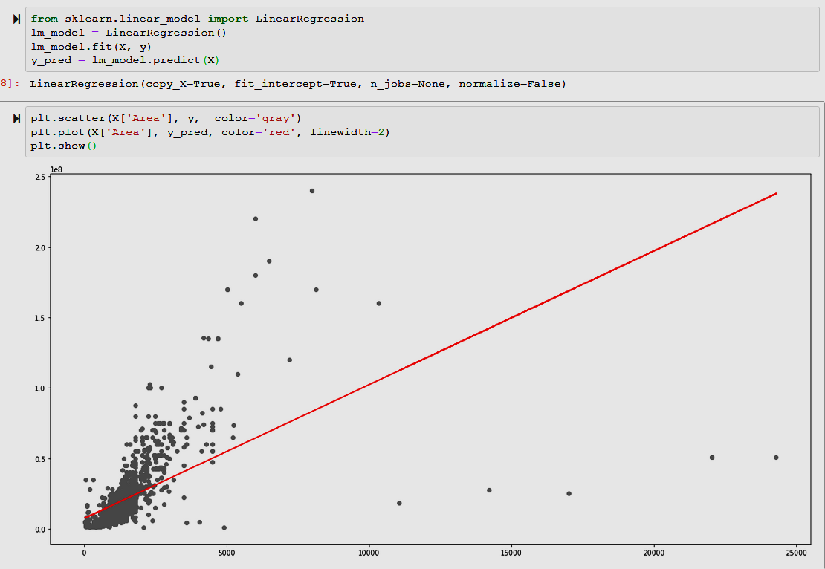
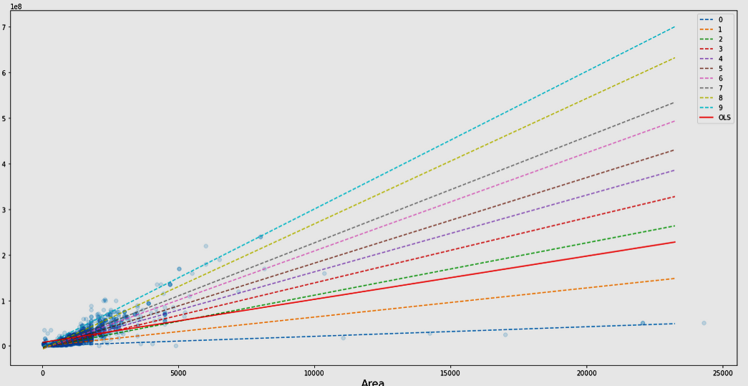
Linear Regression Vs. Quantile Regression
Quantile regression is capable of modeling the entire conditional distribution; this is essential for applications such as ranking the performance of students on standardized exams

Slide 19
2
Data Snap Shot & Linear Fit

Slide 20
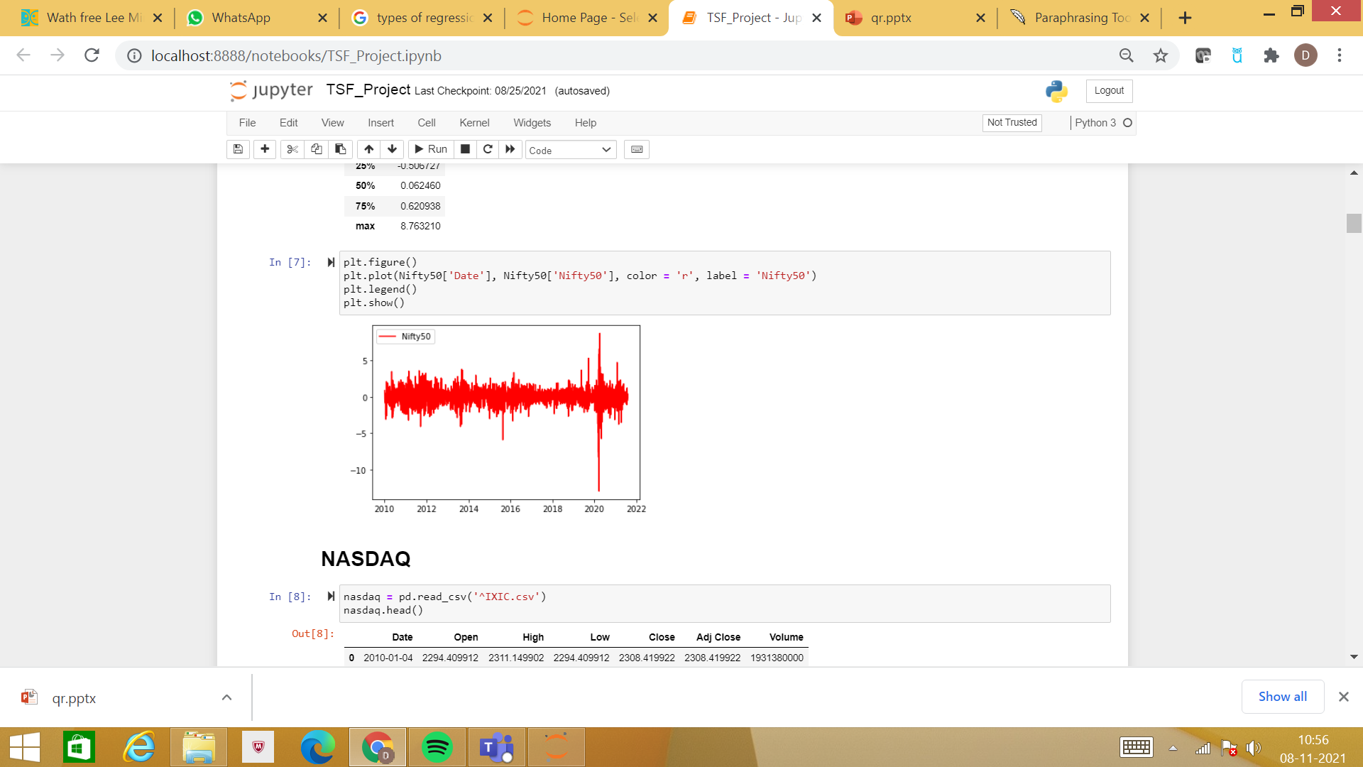
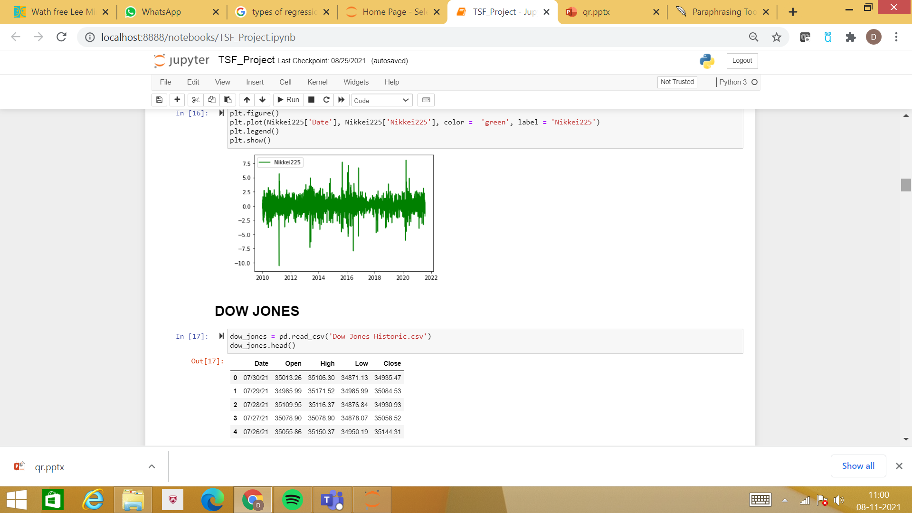
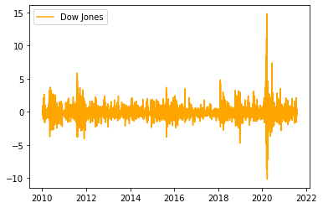
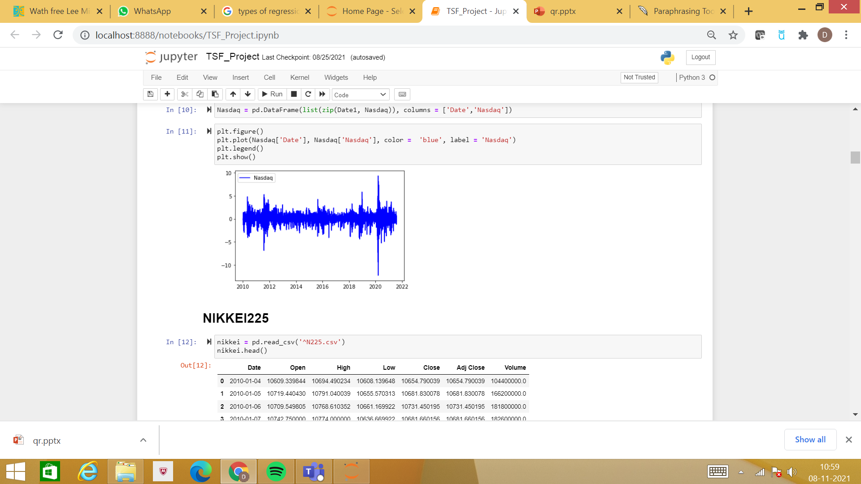
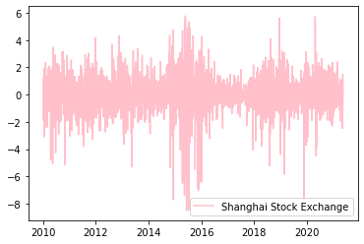
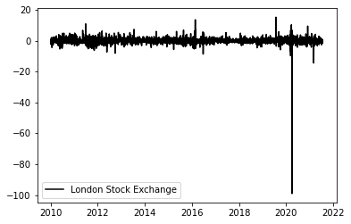
The Global Indices

Slide 21
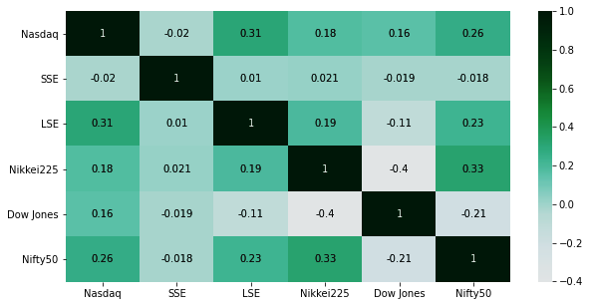
The Unclear Relationship
The image represents the correlation between the dependent and independent variables.
We can observe that Dow Jones has a negative correlation of (-0.21) with Nifty50.
Whereas Nikkei225 and LSE have a positive correlation of 0.33 and 0.23 with Nifty50, respectively.
Nasdaq have a positive relation of 0.26 with Nifty50.
SSE has a negligible correlation with Nifty50

Slide 22
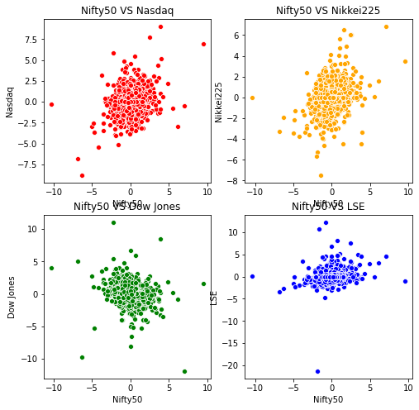
Scatter-ness
The image is a scatterplot of Nifty50 which is the dependent variable with the independent variables like Dow Jones, Nasdaq, LSE and Nikkei
We can see that the data is not following a linear relationship.

Slide 23
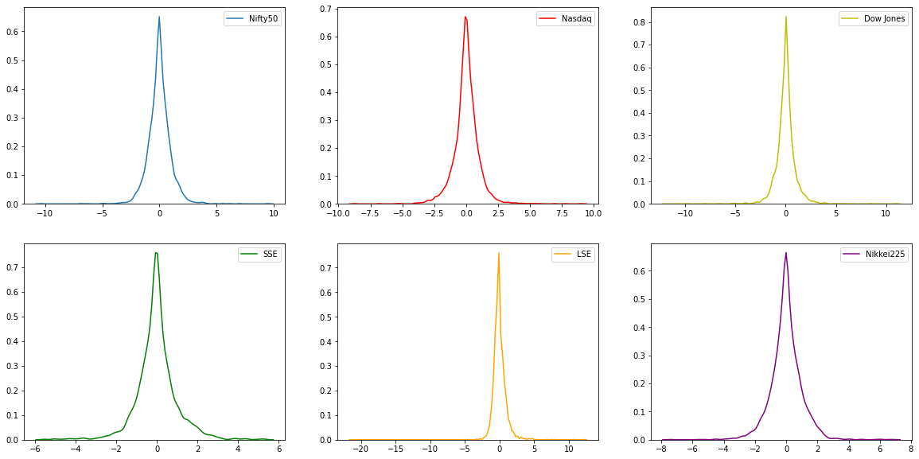
Distribution of the Data

Slide 24
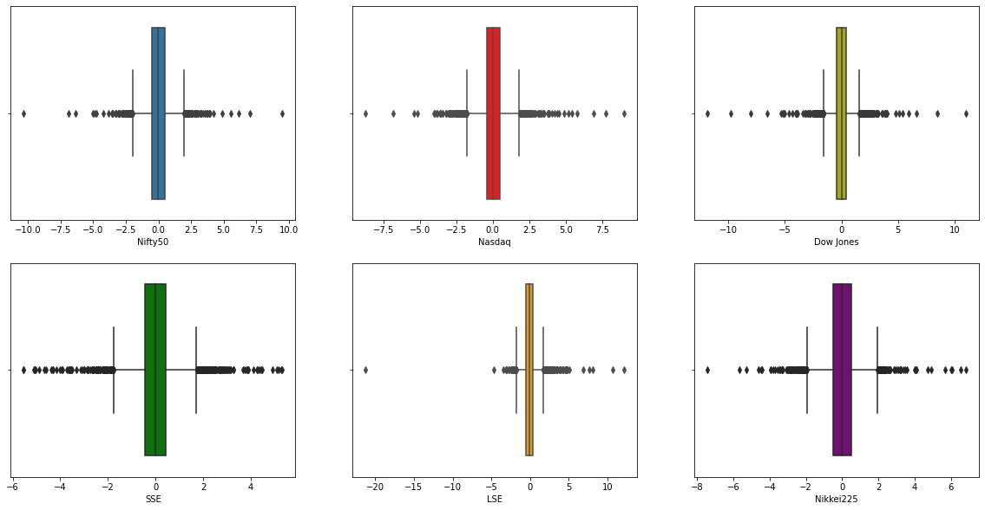
Boxplot for each index

Slide 25
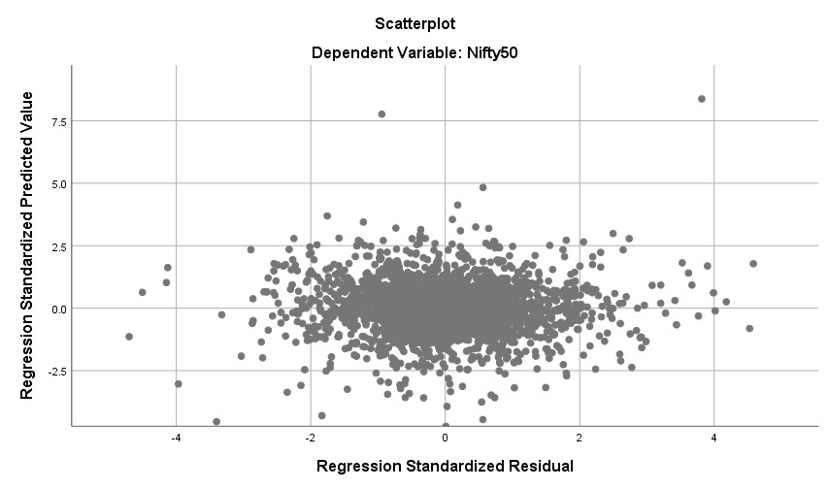
Homoscedasticity Check

Slide 26
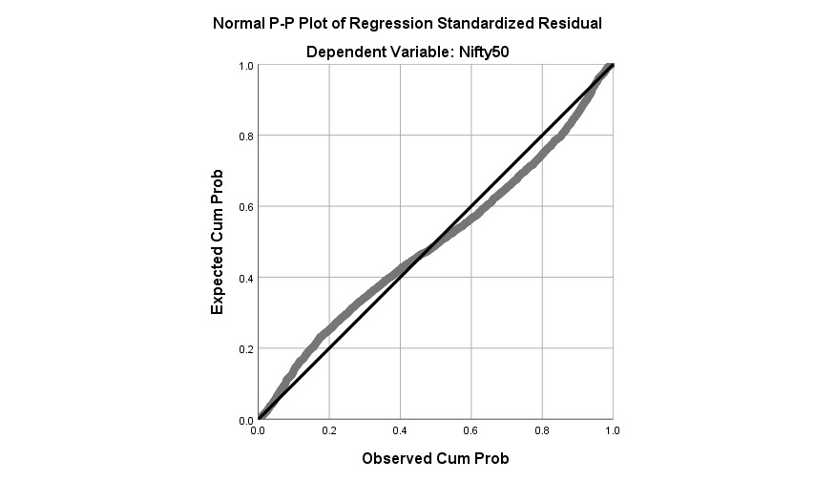
P-P Plot

Slide 27
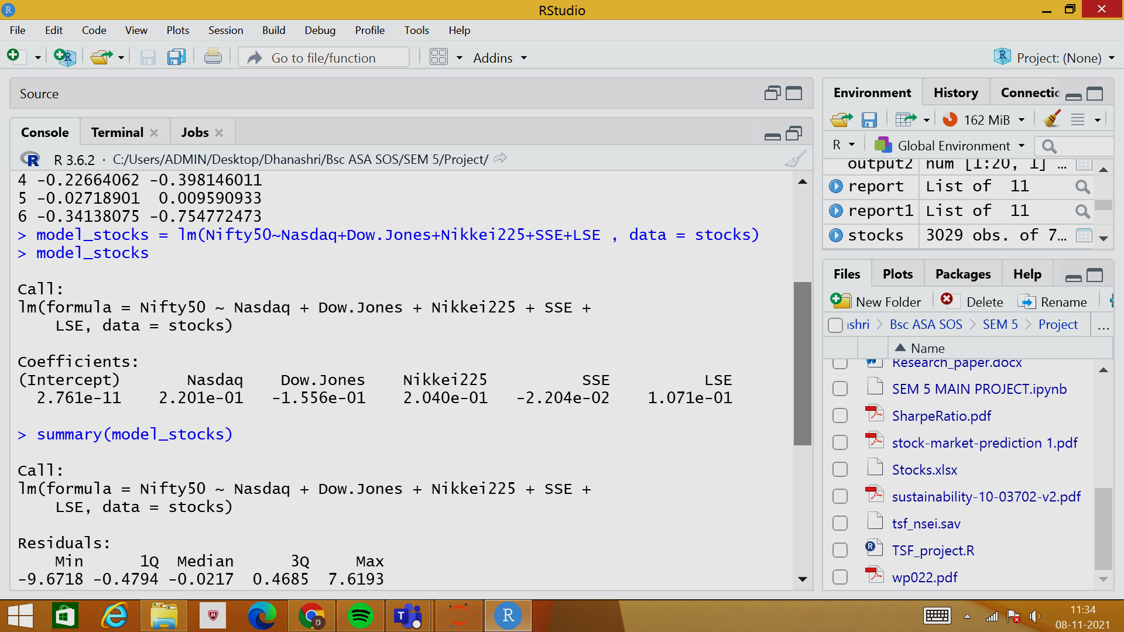
Fitting of Linear Model

Slide 28
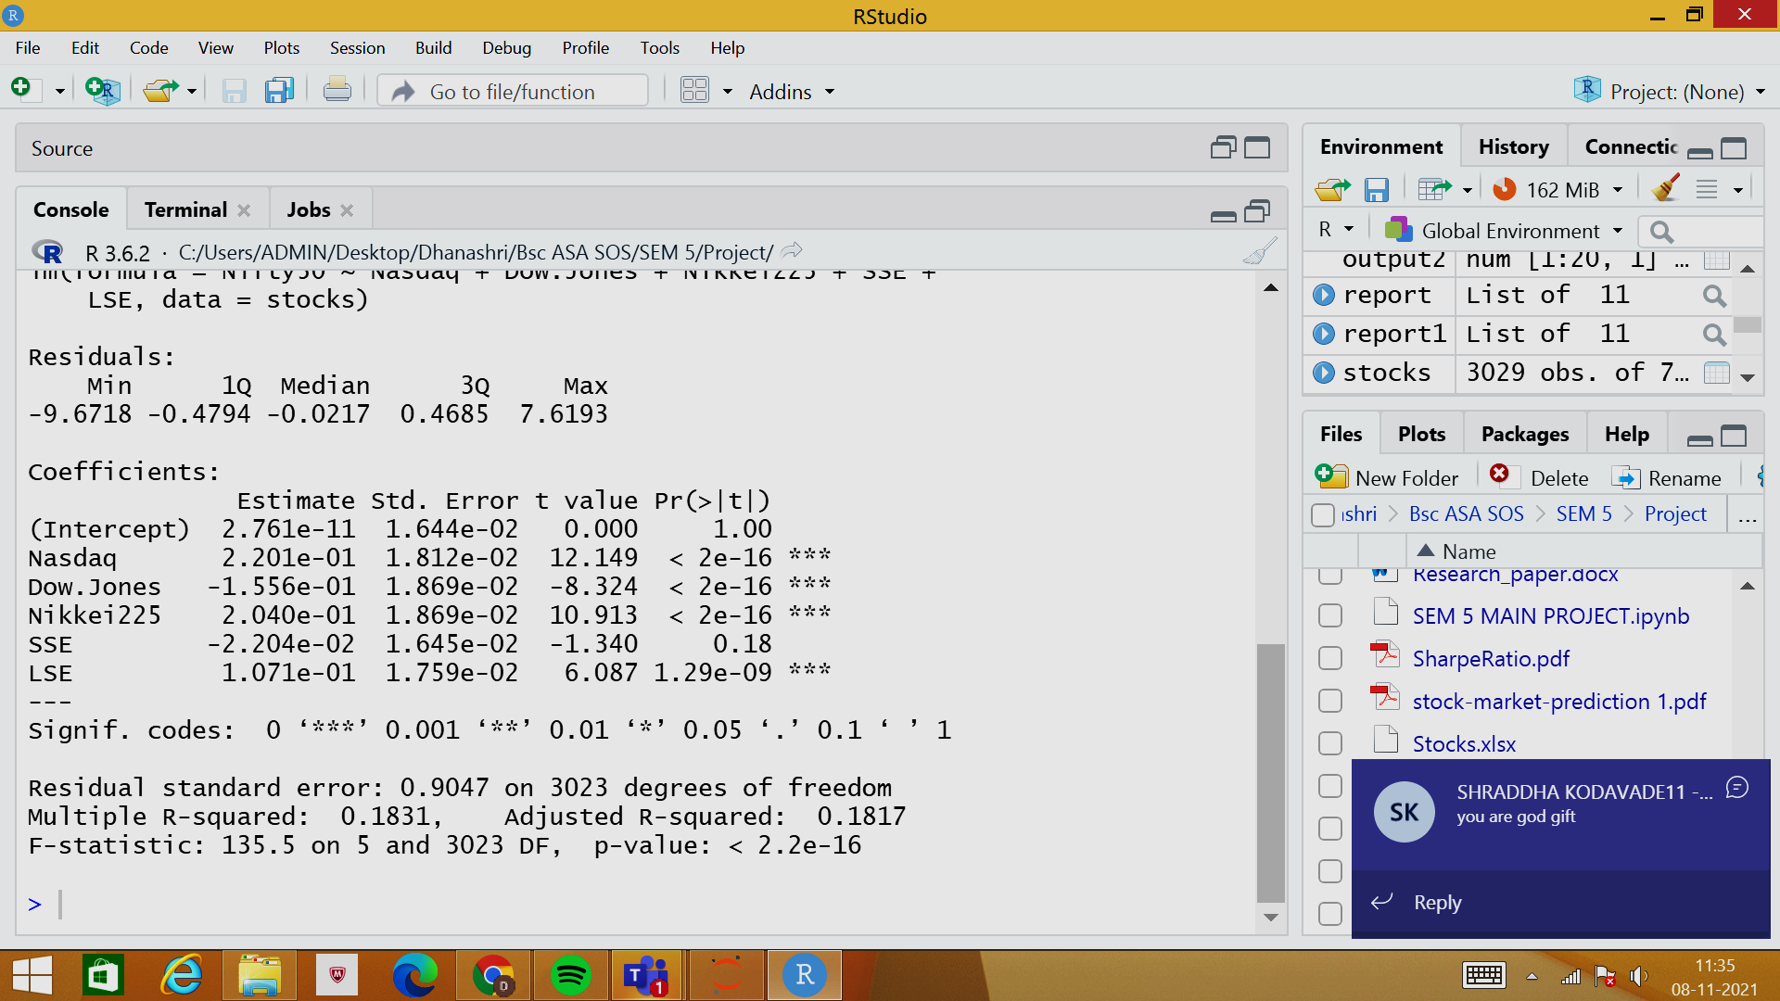
The Adjusted R-squared value is 0.1817.
This shows that the linear model is not a good fit for the data.

Slide 29
3
Quantile Regression Fit
Results and Analysis

Slide 30
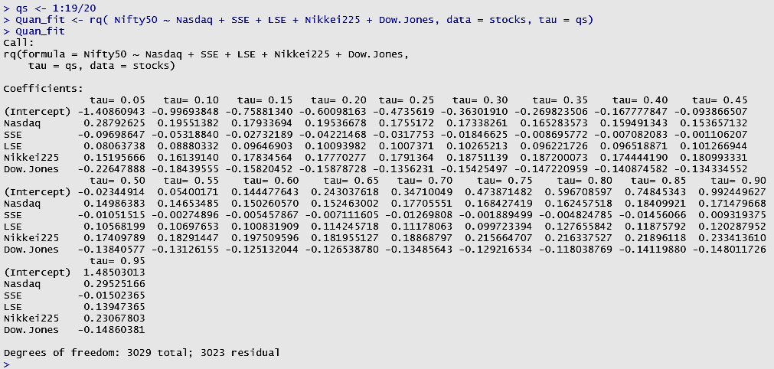
Fitting of Quantile Regression Model

Slide 31
Parameter Values
Tau Values | Intercept | Nasdaq | SSE | LSE | Nikkei225 | DJI
Linear | 0.00000 | 0.22000 | -0.02000 | 0.11000 | 0.20000 | -0.16000
0.05 | -1.40900 | 0.28800 | -0.09700 | 0.08100 | 0.15200 | -0.22600
0.10 | -0.99700 | 0.19600 | -0.05300 | 0.08900 | 0.16100 | -0.18400
0.15 | -0.75881 | 0.17934 | -0.02732 | 0.09647 | 0.17835 | -0.15820
0.20 | -0.60098 | 0.19537 | -0.04221 | 0.10094 | 0.17770 | -0.15879
0.25 | -0.47356 | 0.17552 | -0.03178 | 0.10074 | 0.17914 | -0.13562
0.30 | -0.36302 | 0.17338 | -0.01847 | 0.10265 | 0.18751 | -0.15425
0.35 | -0.26982 | 0.16528 | -0.00870 | 0.09622 | 0.18720 | -0.14722
0.40 | -0.16778 | 0.15949 | -0.00708 | 0.09652 | 0.17444 | -0.14087
0.45 | -0.09387 | 0.15366 | -0.00111 | 0.10127 | 0.18099 | -0.13433
0.50 | -0.02345 | 0.14986 | -0.01052 | 0.10568 | 0.17410 | -0.13841
0.55 | 0.05400 | 0.14653 | -0.00275 | 0.10698 | 0.18291 | -0.13126
0.60 | 0.14448 | 0.15026 | -0.00546 | 0.10083 | 0.19751 | -0.12513
0.65 | 0.24304 | 0.15246 | -0.00711 | 0.11425 | 0.18196 | -0.12654
0.70 | 0.3471 | 0.17706 | -0.01270 | 0.11178 | 0.18869 | -0.13486
0.75 | 0.47387 | 0.16843 | -0.00189 | 0.09972 | 0.21566 | -0.12922
0.80 | 0.59671 | 0.16246 | -0.00482 | 0.12766 | 0.21634 | -0.11804
0.85 | 0.74845 | 0.18410 | -0.01456 | 0.11876 | 0.21896 | -0.14120
0.90 | 0.99245 | 0.17148 | 0.00932 | 0.12029 | 0.23341 | -0.14801
0.95 | 1.48503 | 0.29525 | -0.01502 | 0.13947 | 0.23068 | -0.14860

Slide 32
P – values
Tau Values | Nasdaq | SSE | LSE | Nikkei225 | Dow Jones
0.05 | 0.00000 | 0.02055 | 0.10750 | 0.00000 | 0.00000
0.10 | 0.00000 | 0.01147 | 0.03652 | 0.00000 | 0.00000
0.15 | 0.00000 | 0.24971 | 0.00000 | 0.00000 | 0.00000
0.20 | 0.00000 | 0.03700 | 0.00001 | 0.00000 | 0.00000
0.25 | 0.00000 | 0.06487 | 0.00000 | 0.00000 | 0.00000
0.30 | 0.00000 | 0.24757 | 0.00000 | 0.00000 | 0.00000
0.35 | 0.00000 | 0.57808 | 0.00000 | 0.00000 | 0.00000
0.40 | 0.00000 | 0.62753 | 0.00000 | 0.00000 | 0.00000
0.45 | 0.00000 | 0.93643 | 0.00000 | 0.00000 | 0.00000
0.50 | 0.00000 | 0.43655 | 0.00000 | 0.00000 | 0.00000
0.55 | 0.00000 | 0.85391 | 0.00000 | 0.00000 | 0.00000
0.60 | 0.00000 | 0.74130 | 0.00000 | 0.00000 | 0.00000
0.65 | 0.00000 | 0.67611 | 0.00000 | 0.00000 | 0.00000
0.70 | 0.00000 | 0.48437 | 0.00000 | 0.00000 | 0.00000
0.75 | 0.00000 | 0.92247 | 0.00000 | 0.00000 | 0.00000
0.80 | 0.00000 | 0.80769 | 0.00000 | 0.00000 | 0.00000
0.85 | 0.00000 | 0.54197 | 0.00000 | 0.00000 | 0.00000
0.90 | 0.00000 | 0.76188 | 0.00000 | 0.00000 | 0.00003
0.95 | 0.00000 | 0.75476 | 0.05784 | 0.00000 | 0.00233

Slide 33
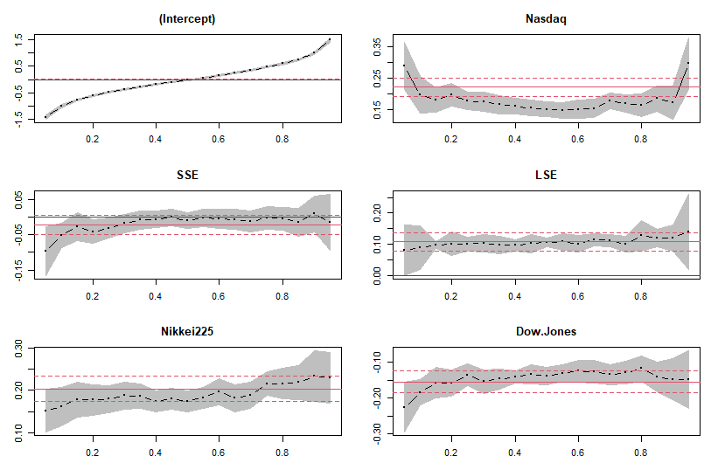

Slide 34
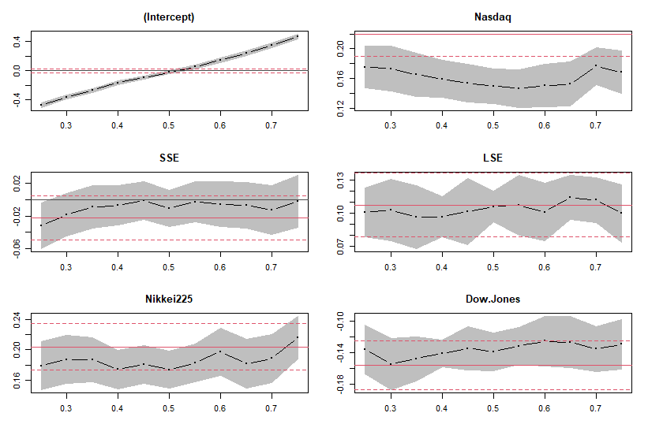
Mid-50% Analysis

Slide 35
Key insights
Nasdaq tends to have a larger impact on net change in Nifty 50 at the extreme 5% of the changes.
Overall, Shanghai seems to be irrelevant in its impact on Nifty 50.
Nasdaq and DJI Paradox
LSE seems consistent and fits well within the linear model’s fit in it’s impact on Nifty 50
The middle 50% of the net changes seem consistent around the linear model fit, with the exception of Nasdaq
In general, stock exchanges fluctuations have an impact on the bottom 10% and top 10% of changes in Nifty 50

Slide 36
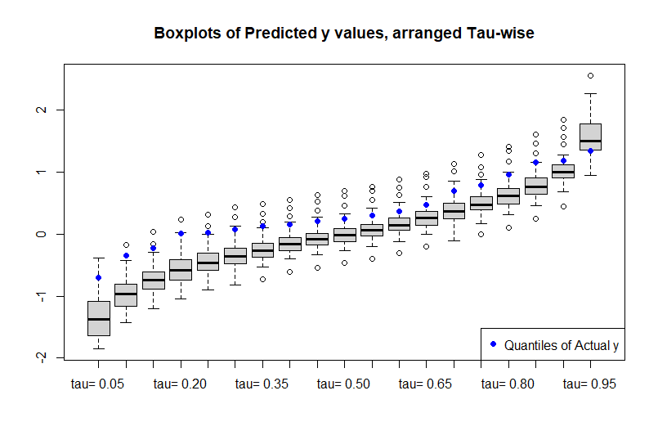
Box Plot of Predicted Values using QR

Slide 37
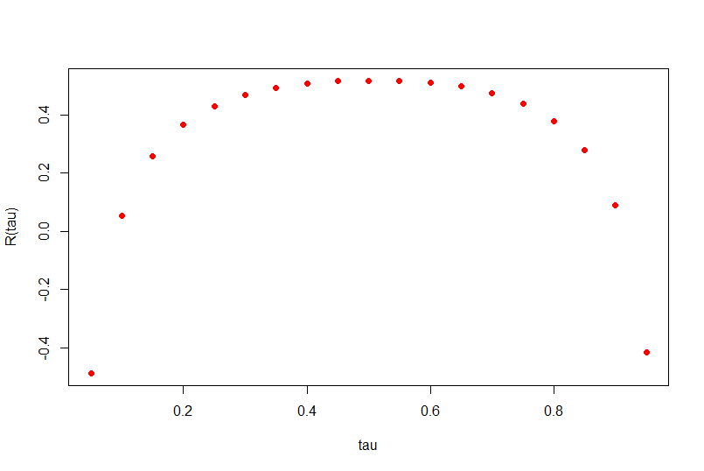
Goodness of Fit with R(tau)
tau | R(tau)
0.05 | -0.48928
0.10 | 0.054245
0.15 | 0.257774
0.20 | 0.365634
0.25 | 0.429002
0.30 | 0.468881
0.35 | 0.494059
0.40 | 0.509346
0.45 | 0.516851
0.50 | 0.518414
0.55 | 0.518414
0.60 | 0.512556
0.65 | 0.499108
0.70 | 0.475141
0.75 | 0.437647
0.80 | 0.37802
0.85 | 0.279436
0.90 | 0.090985
0.95 | -0.41697

Slide 38
Limitations
Developing the mathematical intuition for a more complex set of data might lead to ambiguity in interrelation between the variables.
Not always a combative measure to when a linear model fails.
It involves very lengthy and complicated procedure of calculations and analysis.
Lack of comprehension and jargon for a non – mathematical background client.

Slide 39
Future Scope
Extending the project to a machine learning dimension by finding optimal higher degree fitting curves.
Extending the same into Bayesian statistics for more in depth understanding.
Parallelly studying other research papers, and increasing the adaptability of the project’s problem statement with other statistical methods.
Producing a research paper to contribute to the financial statistical domain.
Sharing the knowledge to various fintech start ups to increase awareness of the intersection of finance, data and statistics.

Slide 40
References
Comparative analysis of Indian stock market. (n.d.). Retrieved November 12, 2021, from https://www.greatlakes.edu.in/pdf/DebijanMukherjee.pdf.
Federal Reserve Bank of Boston. (2002, November 12). A quantile regression analysis of the cross section of stock market returns. Federal Reserve Bank of Boston. Retrieved November 12, 2021, from https://www.bostonfed.org/publications/research-department-working-paper/2002/a-quantile-regression-analysis-of-the-cross-section-of-stock-market-returns.aspx.
© 2017 JETIR February 2017, volume 4 - researchgate.net. (n.d.). Retrieved November 12, 2021, from https://www.researchgate.net/profile/Manjula-Ka/publication/344852865_A_STUDY_OF_RELATIONSHIP_BETWEEN_INDIAN_AND_ASIAN_STOCK_MARKETS_USING_MACHINE_LEARNING_TECHNIQUES/links/5f93cadc299bf1b53e4079aa/A-STUDY-OF-RELATIONSHIP-BETWEEN-INDIAN-AND-ASIAN-STOCK-MARKETS-USING-MACHINE-LEARNING-TECHNIQUES.pdf.
Mensi, W., Hammoudeh, S., Reboredo, J. C., & Nguyen, D. K. (2014, April 13). Do global factors impact BRICS stock markets? A quantile regression approach. Emerging Markets Review. Retrieved November 12, 2021, from https://www.sciencedirect.com/science/article/abs/pii/S156601411400017X.
Koenker, R., & Hallock, K. F. (n.d.). Quantile regression. Journal of Economic Perspectives. Retrieved November 12, 2021, from https://www.aeaweb.org/articles?id=10.1257%2Fjep.15.4.143.

Slide 41
Acknowledgements
We would like to acknowledge and express our gratitude to our Mentor, Dr. Hemant Kulkarni sir, for helping us structure, format and understand the concepts employed in this project.
We would like to thank NMIMS deemed to be University, Navi Mumbai, for providing us with this opportunity, and provide with us with the necessary tools and resources.
Lastly, we would express our gratitude to the various sources, academicians and students from other universities who contributed and helped us build this project.

Slide 42



Our Team
Dhanashri Kanitkar
Hrishita Bapuram
Shraddha Kodavade

Slide 43
Thanks!

